Slide 1
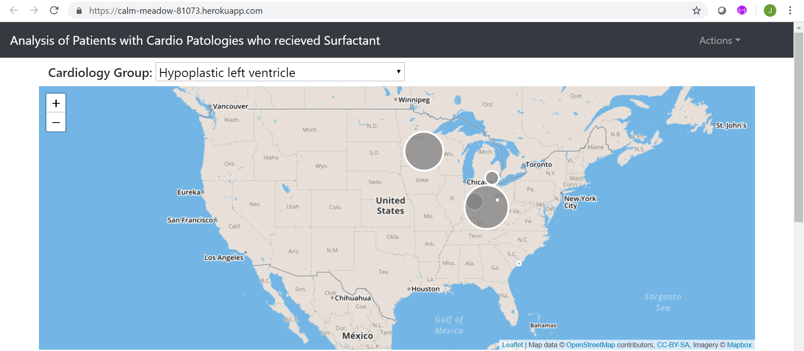
Analysis of Patients with Cardio Pathologies who were treated with Surfactant

Slide 2
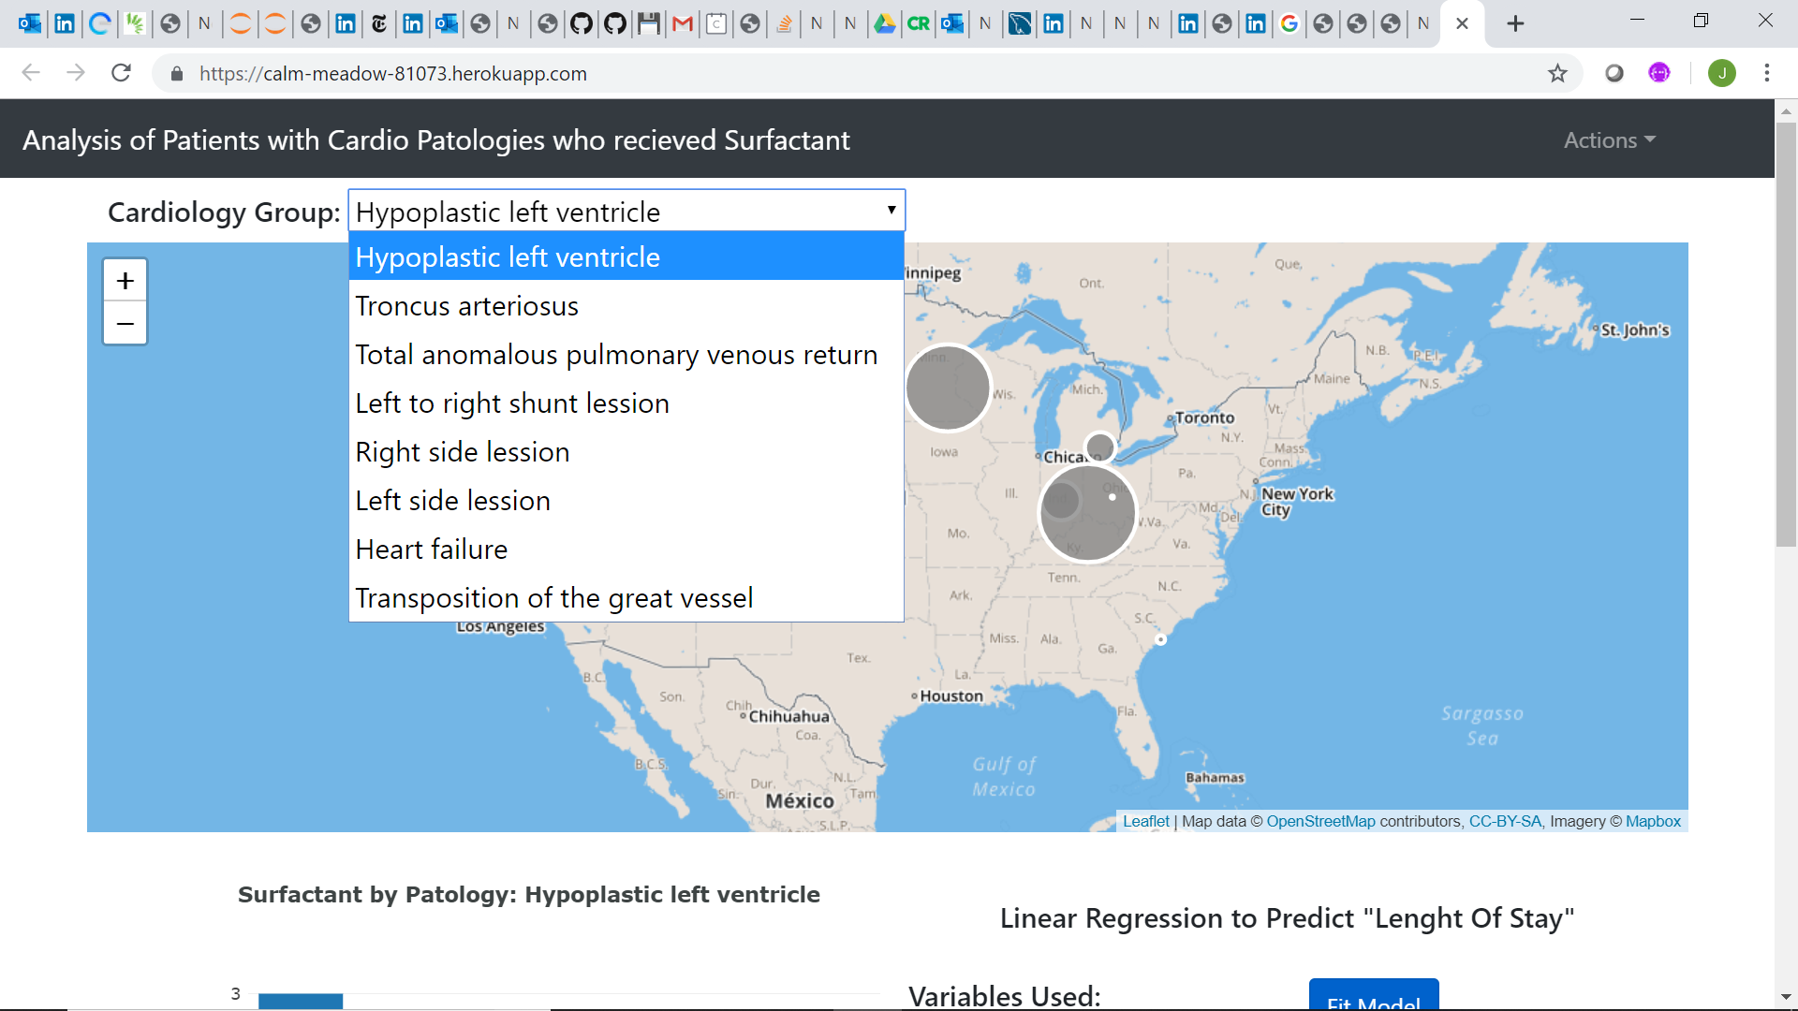
Pathology Groups:
Hypoplastic Left Ventricle
Troncus Arteriosus
Total anomalous pulmonary venous return
Left to right shunt lesion
Right side lesion
Left side lesion
Heart failure
Transposition of the great vessel

Slide 3
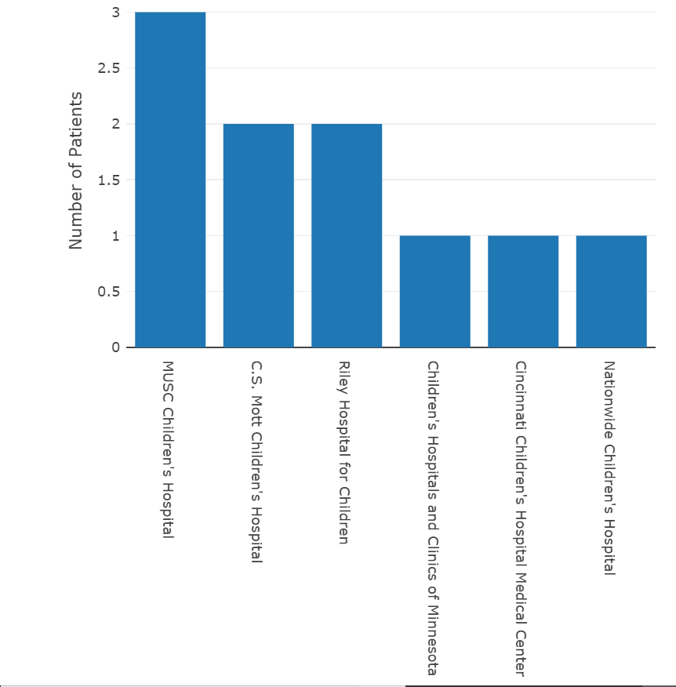
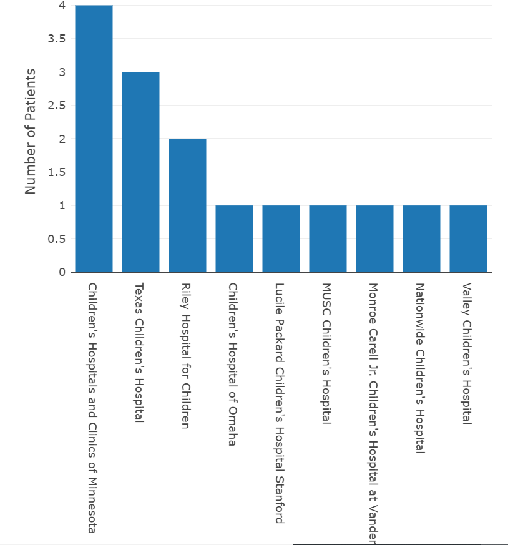
Number of Patients with Surfactant
Hypoplastic left ventricle
Troncus arteriosus

Slide 4
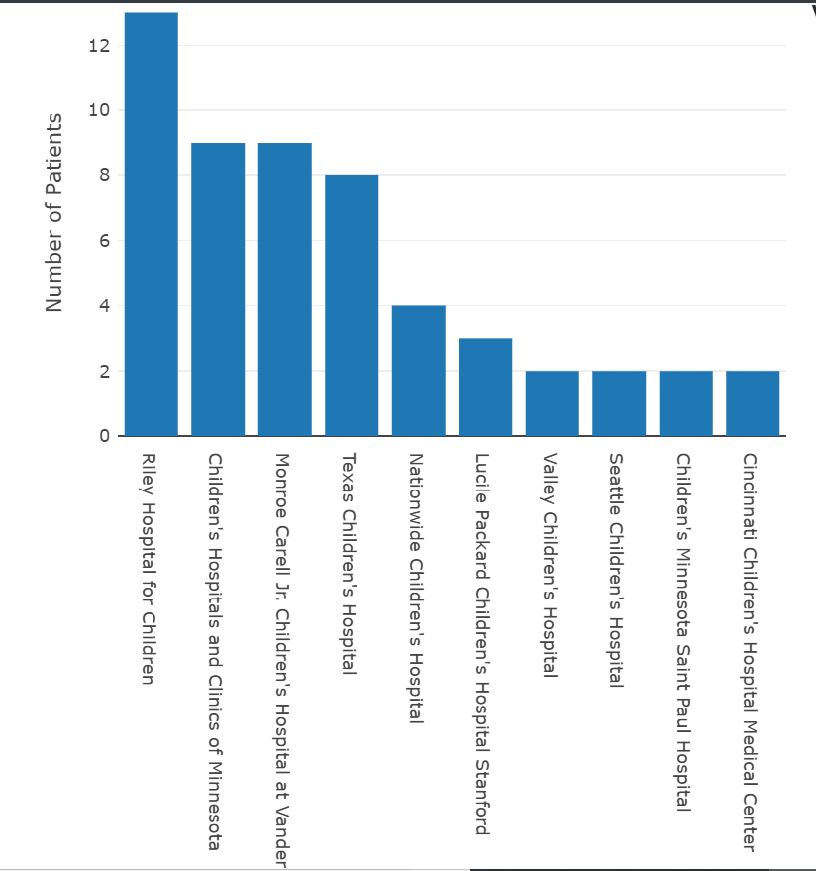
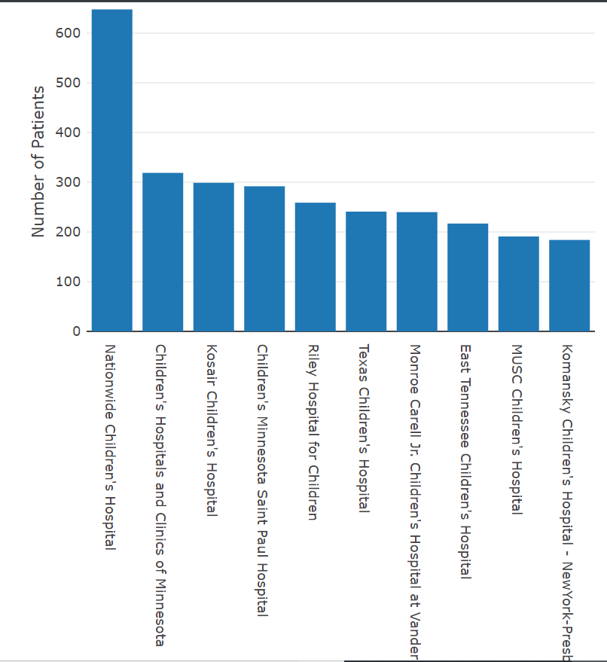
Number of Patients with Surfactant
Anomalous pulmonary venous return
Left to right shunt lesion
Hypoplastic left ventricle

Slide 5
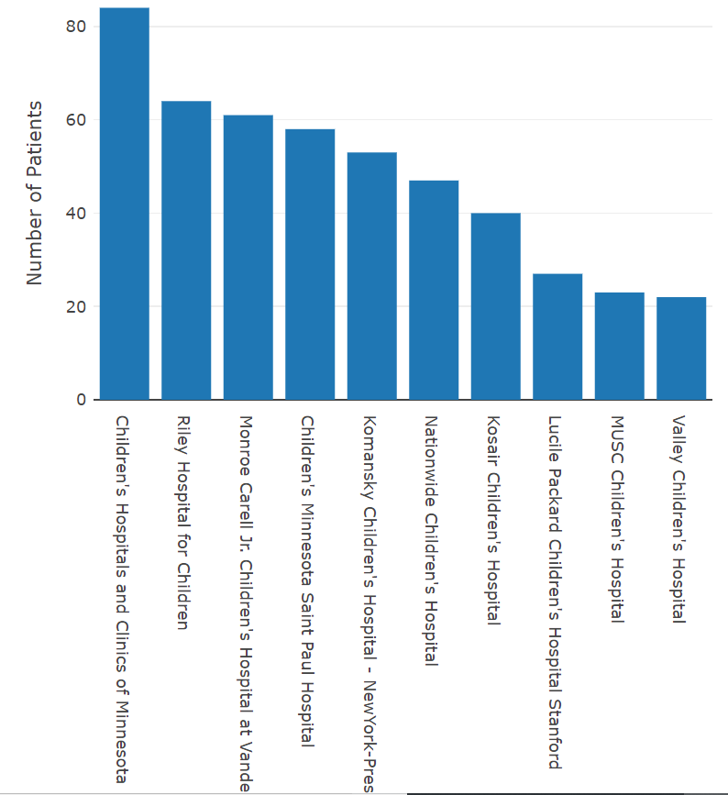
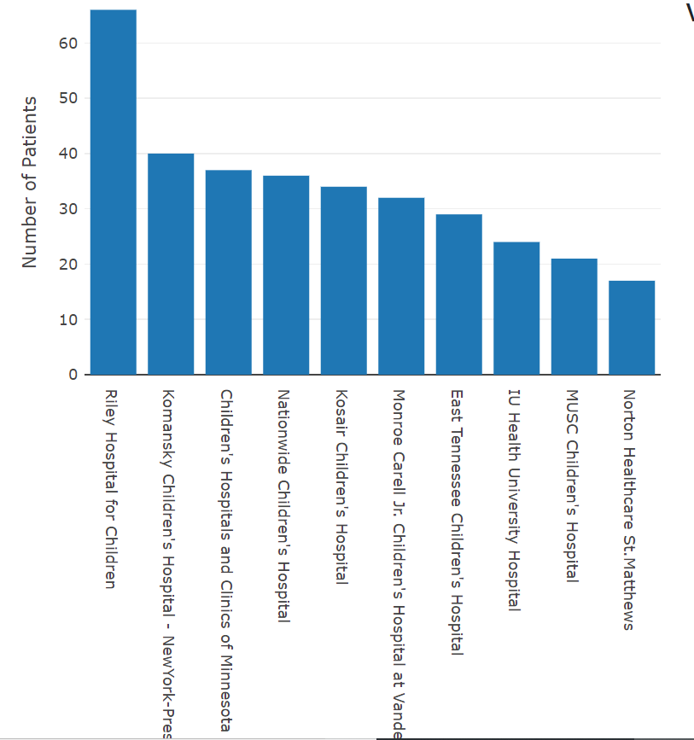
Number of Patients with Surfactant
Left side lesion
Right side lesion

Slide 6
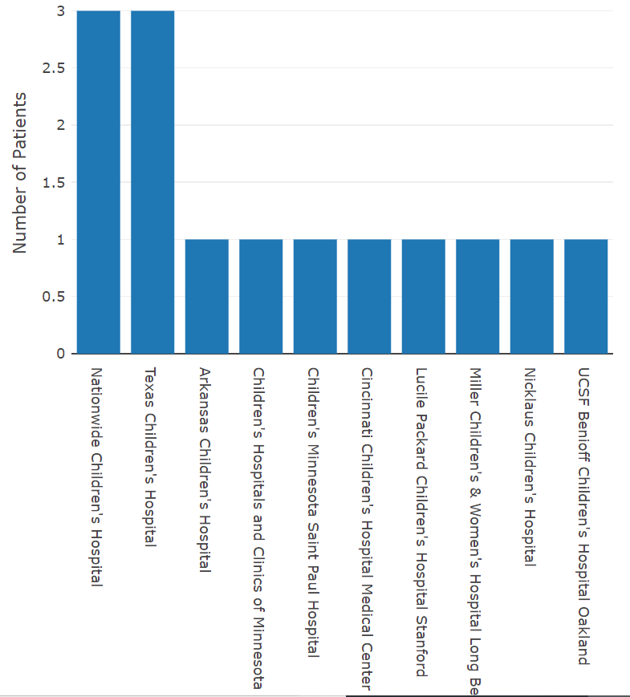
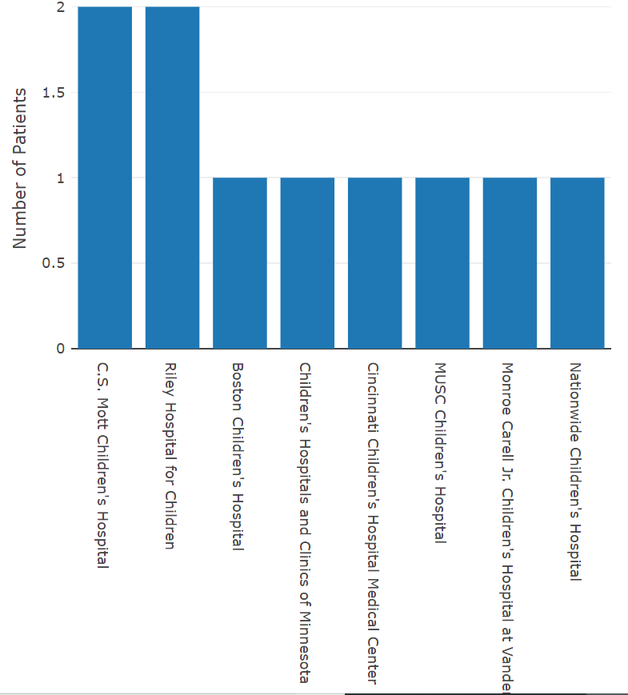
Number of Patients with Surfactant
Heart failure
Transposition of the great vessel

Slide 7
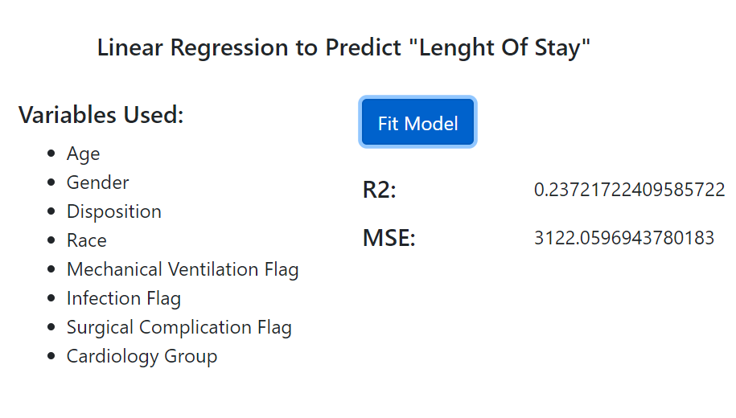

Slide 8

Conclusions
Surfactant use more prevalent in side lesions
Hospital stay of length of various month is not rare
Variables used to predict the length of stay are not enough to explain the model
It is recommended to use clinical data instead of the billing data to study the length of stay

